Slide 1

3
Chapter
Integrative
Managerial
Issues
Copyright ©2015 Pearson Education, Inc.
3-<number>

Slide 2
Learning Outcomes
Explain globalization and its impact on organizations.
  Today’s managers are concerned with such integrative managerial issues as diversity, globalization, and ethics and social responsibility throughout many aspects of what they do and how they manage.
Discuss how society’s expectations are influencing managers and organizations.
Copyright ©2015 Pearson Education, Inc.
3-<number>

Slide 3
Learning Outcomes (cont.)
Describe how the workforce is changing and its impact on the way organizations are managed.
Copyright ©2015 Pearson Education, Inc.
3-<number>

Slide 4
3.1
Explain globalization and its impact on organizations.
Copyright ©2015 Pearson Education, Inc.
3-<number>

Slide 5
Globalization and its Impact
  Global village
  a boundaryless world where goods and services are produced and marketed worldwide.
Copyright ©2015 Pearson Education, Inc.
3-<number>

Slide 6
American companies get well over half of their annual revenues from sales outside North America.
Global sales (Outside North America) for:
Avon 88%
McD’s 68%
IBM 58%
Coke 55%
GE 52%
Apple 51%
1-<number>

Slide 7
What Does it Mean to Be “Global”?
Exchanging goods and services with consumers in other countries.
  Market globalization
Using managerial and employee talent from other countries.
  Immigration laws and regulations
Using financial sources and resources outside home country.
  Financial globalization
Copyright ©2015 Pearson Education, Inc.
3-<number>

Slide 8
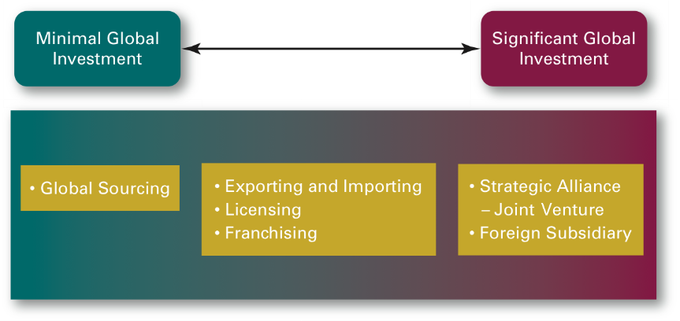
How Do Organizations Go Global?
Copyright ©2015 Pearson Education, Inc.
3-<number>

Slide 9
Managers who want to enter a global market with minimal investment usually start with global sourcing (also called global outsourcing), which means purchasing materials or labor from the cheapest source in order to maintain a competitive edge.
Copyright ©2015 Pearson Education, Inc.
1-<number>

Slide 10
  Exporting and importing need less investment and risk than other steps in globalization.
  Exporting an organization’s products involves making products domestically and selling them abroad.
  Importing involves acquiring products made abroad and selling them domestically.
Copyright ©2015 Pearson Education, Inc.
1-<number>

Slide 11
  Managers may also choose licensing or franchising to further their global penetration.
  Both licensing and franchising involve one organization giving another organization the right to use its brand name, technology, or product specifications in return for a lump sum payment or a fee that is usually based on sales.
Copyright ©2015 Pearson Education, Inc.
1-<number>

Slide 12
  Licensing is most often used by manufacturing organizations that make or sell another company’s products.
Copyright ©2015 Pearson Education, Inc.
1-<number>

Slide 13
  Franchising is primarily used by service organizations that want to use another company’s name and operating methods.
  Example: McD’s, KFC and Dunkin’ Donuts.
Copyright ©2015 Pearson Education, Inc.
1-<number>

Slide 14
  With experience in international markets, managers may next make a more direct investment through a global strategic alliance, which is a partnership between an organization and a foreign company partner created to share resources and knowledge in developing new products or building production facilities.
Copyright ©2015 Pearson Education, Inc.
1-<number>

Slide 15
  - A joint venture is a type of strategic alliance in which the partners form a separate, independent organization for a business purpose.
Copyright ©2015 Pearson Education, Inc.
1-<number>

Slide 16
  Managers may also directly invest in a foreign country by setting up a foreign subsidiary as a separate and independent facility or office.
Copyright ©2015 Pearson Education, Inc.
1-<number>

Slide 17
Types of Global Organizations
MNC (multinational corporation)
Any type of international company that maintains operations in multiple countries.
Types are:
  Multidomestic corporation
  Global corporation
Copyright ©2015 Pearson Education, Inc.
3-<number>

Slide 18
Multidomestic corporation: management and other decisions are decentralized to the local country in which it is operating.
Rely on local employees to manage the business
Tailor strategies to each country’s unique characteristics
Copyright ©2015 Pearson Education, Inc.
1-<number>

Slide 19
Global corporation: An MNC in which management and other decisions are centralized in the home country.
World market is treated as an integrated whole
Focus is on control and global efficiency.
Copyright ©2015 Pearson Education, Inc.
1-<number>

Slide 20
Managing in a Global Organization
A person with a parochial attitude cannot succeed in today’s world.
Parochialism is a narrow focus in which managers see things only through their own eyes and from their own perspectives – not recognizing that countries have different values, morals, customs, political and economic systems, and laws – which can affect how a business is managed.
Copyright ©2015 Pearson Education, Inc.
3-<number>

Slide 21
The most important differences for managers to understand relate to a country’s social context or culture.
Example; status is perceived differently in different countries.
  In France, status is often the result of factors important to the organization, such as seniority, education.
  In the United States, status is more a function of what individuals have accomplished personally.
Copyright ©2015 Pearson Education, Inc.
1-<number>

Slide 22
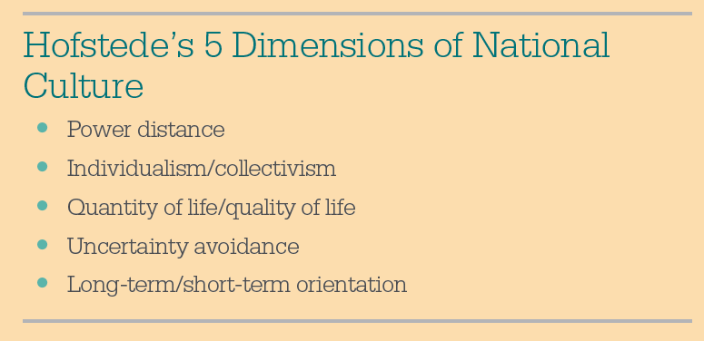
Hofstede’s Framework
Copyright ©2015 Pearson Education, Inc.
3-<number>

Slide 23
Power distance, which is the degree to which people in a country accept that institutional power is distributed unequally
Copyright ©2015 Pearson Education, Inc.
1-<number>

Slide 24
Individualism versus collectivism, which is the degree to which people in a country prefer to act as individuals or as members of groups
Copyright ©2015 Pearson Education, Inc.
1-<number>

Slide 25
Quantity of life, which values assertiveness, materialism, and competition, versus quality of life, which values relationships and sensitivity and concern for others’ welfare
Copyright ©2015 Pearson Education, Inc.
1-<number>

Slide 26
Uncertainty avoidance, which is the degree to which people in a country prefer structured over unstructured situations and whether they are willing to take risks
Copyright ©2015 Pearson Education, Inc.
1-<number>

Slide 27
Long-term orientation, which is the degree to which people look to the future and value thrift and persistence, versus short-term orientation, which is the degree to which people value the past and present and emphasizes respect for tradition and fulfilling social obligations.
Copyright ©2015 Pearson Education, Inc.
1-<number>

Slide 28
GLOBE Findings
Global Leadership and Organizational Behavior Effectiveness (GLOBE) research program, a program studies cross-cultural leadership behaviors.
The GLOBE research team, using data from more than 17,000 managers in 62 societies around the world, has identified nine dimensions in which national cultures differ
Copyright ©2015 Pearson Education, Inc.
3-<number>

Slide 29
GLOBE: 9 Dimensions of Cultural Difference
6. Individualism/ Collectivism
7. In-group collectivism
8. Performance orientation
9. Humane orientation
1. Assertiveness
2. Future orientation
3. Gender differentiation
4. Uncertainty avoidance
5. Power distance
Copyright ©2015 Pearson Education, Inc.
3-<number>

Slide 30
Discuss how society’s expectations are influencing managers and organizations.
3.2
Copyright ©2015 Pearson Education, Inc.
3-<number>

Slide 31
Many managers believe that society expects organizations and managers to be responsible and ethical
Copyright ©2015 Pearson Education, Inc.
1-<number>

Slide 32

Society’s Expectations
In this photo, we see a youngster with a specially made football that won’t deflate or puncture thanks to the “One World Futbol Project” sponsored by GM Chevrolet. With the goal of improving society’s welfare, the company is donating 1.5 million balls for needy kids around the world as a way of providing healthy and lasting play for them.
Copyright ©2015 Pearson Education, Inc.
1-<number>

Slide 33
Social Responsibility
  refers to a business’s intention, beyond its legal and economic obligations, to do the right things and act in ways that are good for society.
  Corporate social responsibility (CSR)
Copyright ©2015 Pearson Education, Inc.
3-<number>

Slide 34
  Social obligations are activities a business engages in to meet certain economic and legal responsibilities.
  It does the minimum that the law requires and only pursues social goals to the extent that they contribute to its economic goals.
  Social responsiveness is characteristic of the business firm that engages in social actions in response to a popular social need.
  Managers in these companies are guided by social norms and values and make practical, market-oriented decisions about their actions.
1-<number>

Slide 35
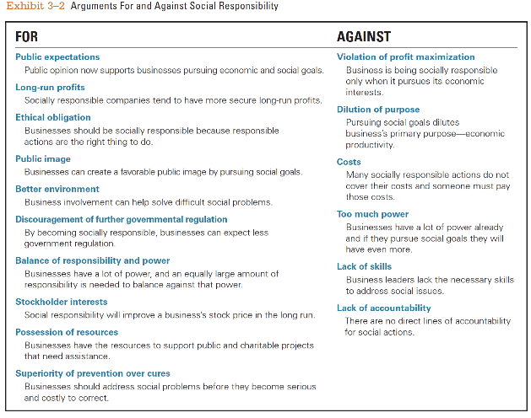
Should Organizations be Socially Involved?
3-<number>

Slide 36
Sustainability Means Different Things to Different People
Meeting the needs of people today without compromising the ability of future generations to meet their own needs.
A company’s ability to achieve its business goals and increase long-term shareholder value by integrating economic, environmental, and social opportunities into its business strategies.
Copyright ©2015 Pearson Education, Inc.
3-<number>

Slide 37
Describe how the workforce is changing and its impact on the way organizations are managed.
3.4
Copyright ©2015 Pearson Education, Inc.
3-<number>

Slide 38
The Changing Workforce
Diversity is visible in age, gender, race, physical attributes, styles of dress, and personality type.
Copyright ©2015 Pearson Education, Inc.
3-<number>

Slide 39
Workplace Diversity
Workforce diversity
the ways in which people in an organization are both different from and similar to one another.
Copyright ©2015 Pearson Education, Inc.
3-<number>

Slide 40
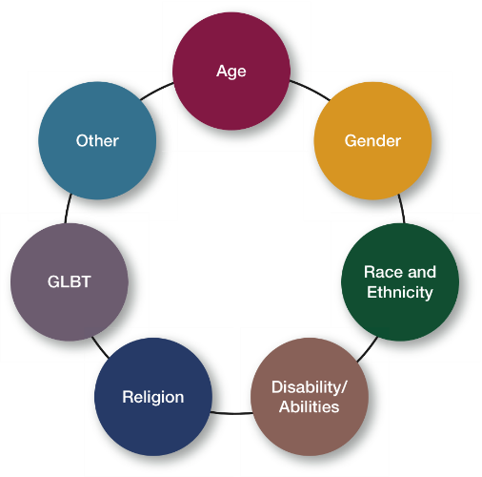
Types of Diversity
Copyright ©2015 Pearson Education, Inc.
3-<number>

Slide 41
Adapting to a Changing Workforce
  Work-life balance programs
  Contingent workforce
  Generational differences
Copyright ©2015 Pearson Education, Inc.
3-<number>

